Slide 1



Rotating Machines diagnosis with Time-Frequency Analysis: Focus on Helicopter Gearboxes
10 November 2023
Anas Had
LASPI
UJM - Saint Etienne

Slide 2

About me
Full Name : HAD Anas
Lecturer and researcher at the Sciences and technologies Faculty – UJM (Since 2021)
Laboratory : LASPI – IUT de Roanne.
Research domain : Signal processing – Rotating Machine diagnosis / health monitoring – Biomedical signal processing – Sparsity

Slide 3
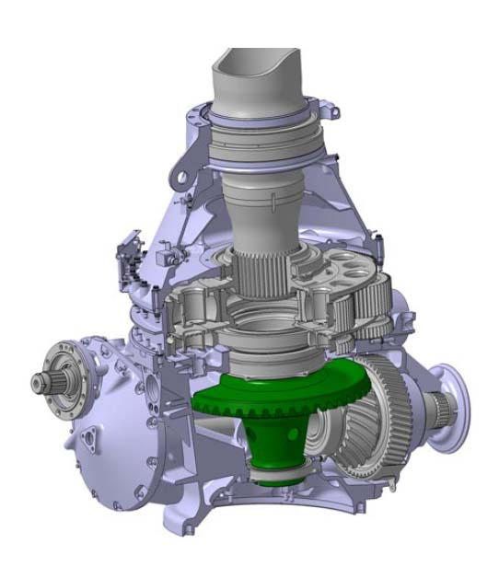
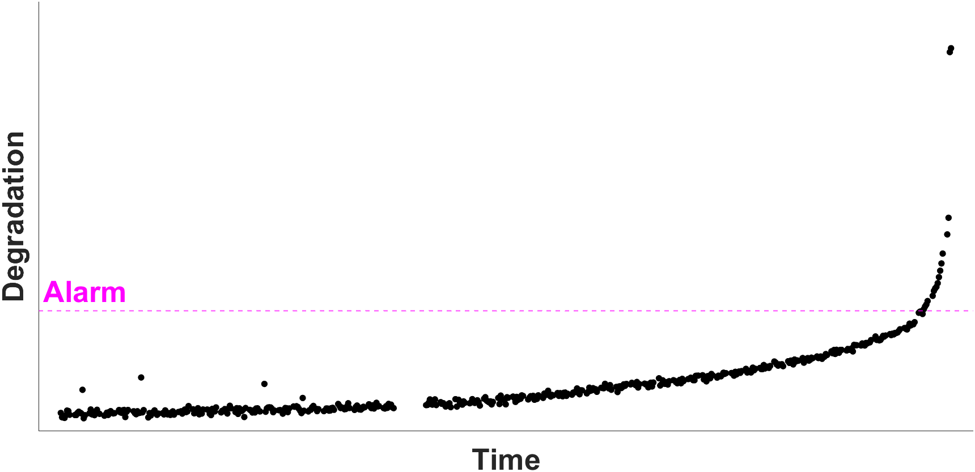
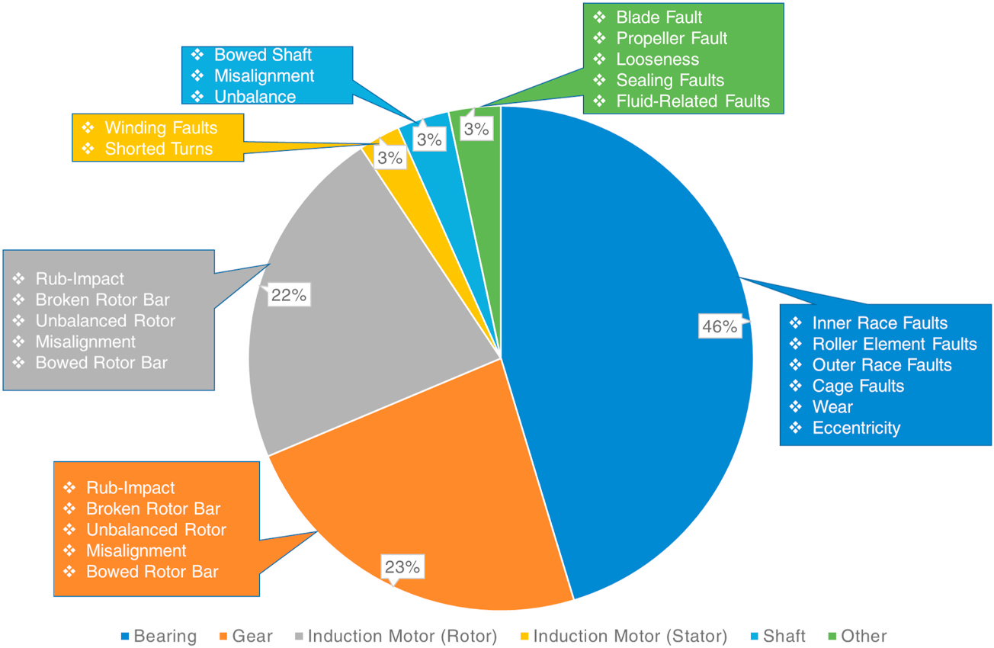
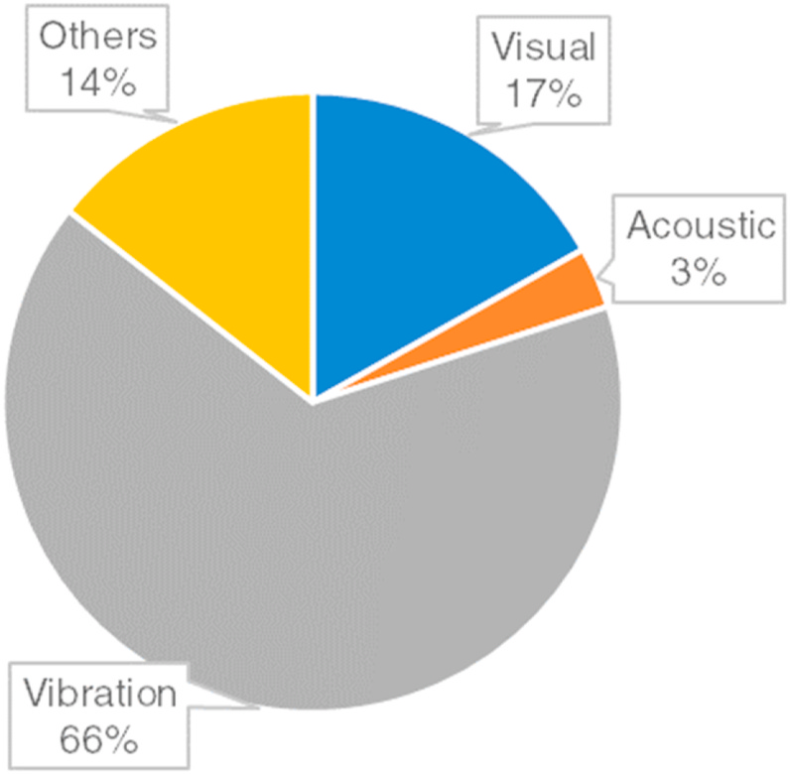
Context – Problem – Objectives
Machine health monitoring
Why Monitor rotating machines?
Rotating Machines are an indispensable element in the industry
They need to be functional all time for production in good conditions
Prevent a catastrophic failure can lead to expensive repairs and hurt the operators
Measurement : Vibration data, Tachometer data, Acoustic…
Objective :
  Early detection of a mechanical component degradation.
  Accurate tracking of the fault progression.
Das, O., Das, D. B., & Birant, D. (2023). Machine learning for fault analysis in rotating machinery: A comprehensive review. Heliyon.

Slide 4
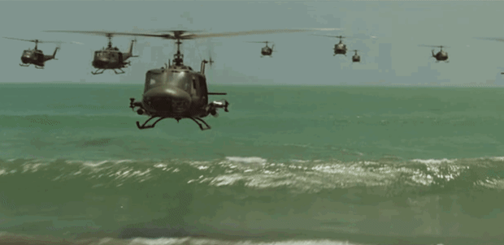
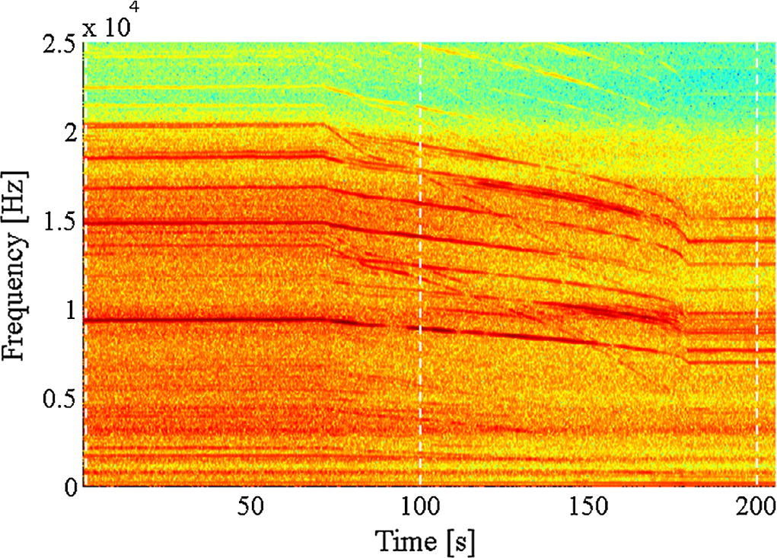
Context – Problem – Objectives
Problem definition
Most of the proposed rotating machines diagnostic techniques assume the stationarity of the signals.
Problem: How to overcome the time varying conditions for the detection of rotating machines faults?
Solution: Time-Frequency Representations !!
Constraints :
- From time-frequency maps to scalar indicators.
- Robust for different functioning conditions.
- Detect at first sight.

Slide 5

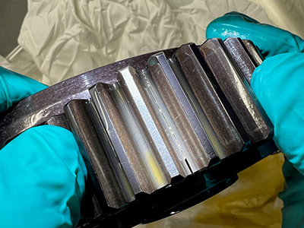
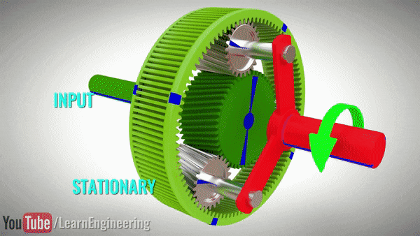
Helicopter Gearboxes
Epicyclic Gearbox
Why planetary gearbox ?
Compact design with high torque multiplication ratio
They allow for load sharing among multiple gears, which can enhance durability and efficiency.
URL : https://www.youtube.com/watch?v=0ZbTN6pM2SE

Slide 6
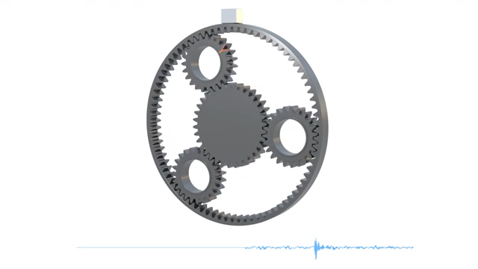
Planetary gears anisotropy detection
General approach (Proposed by Airbus Helicopters)
Aim : Use vibration data to detect planet gears anisotropy in a helicopter main gearbox.
Key idea : The presence of a planet gear anisotropy is highlighted by the presence of the same time-frequency patterns across multiple adjacent signals.
The proposed general approach :
Accelerometer sensor
Computation of two time-frequency fault map for two adjacent signals.
Computation of similarity indicator between two adjacent maps.

Slide 7
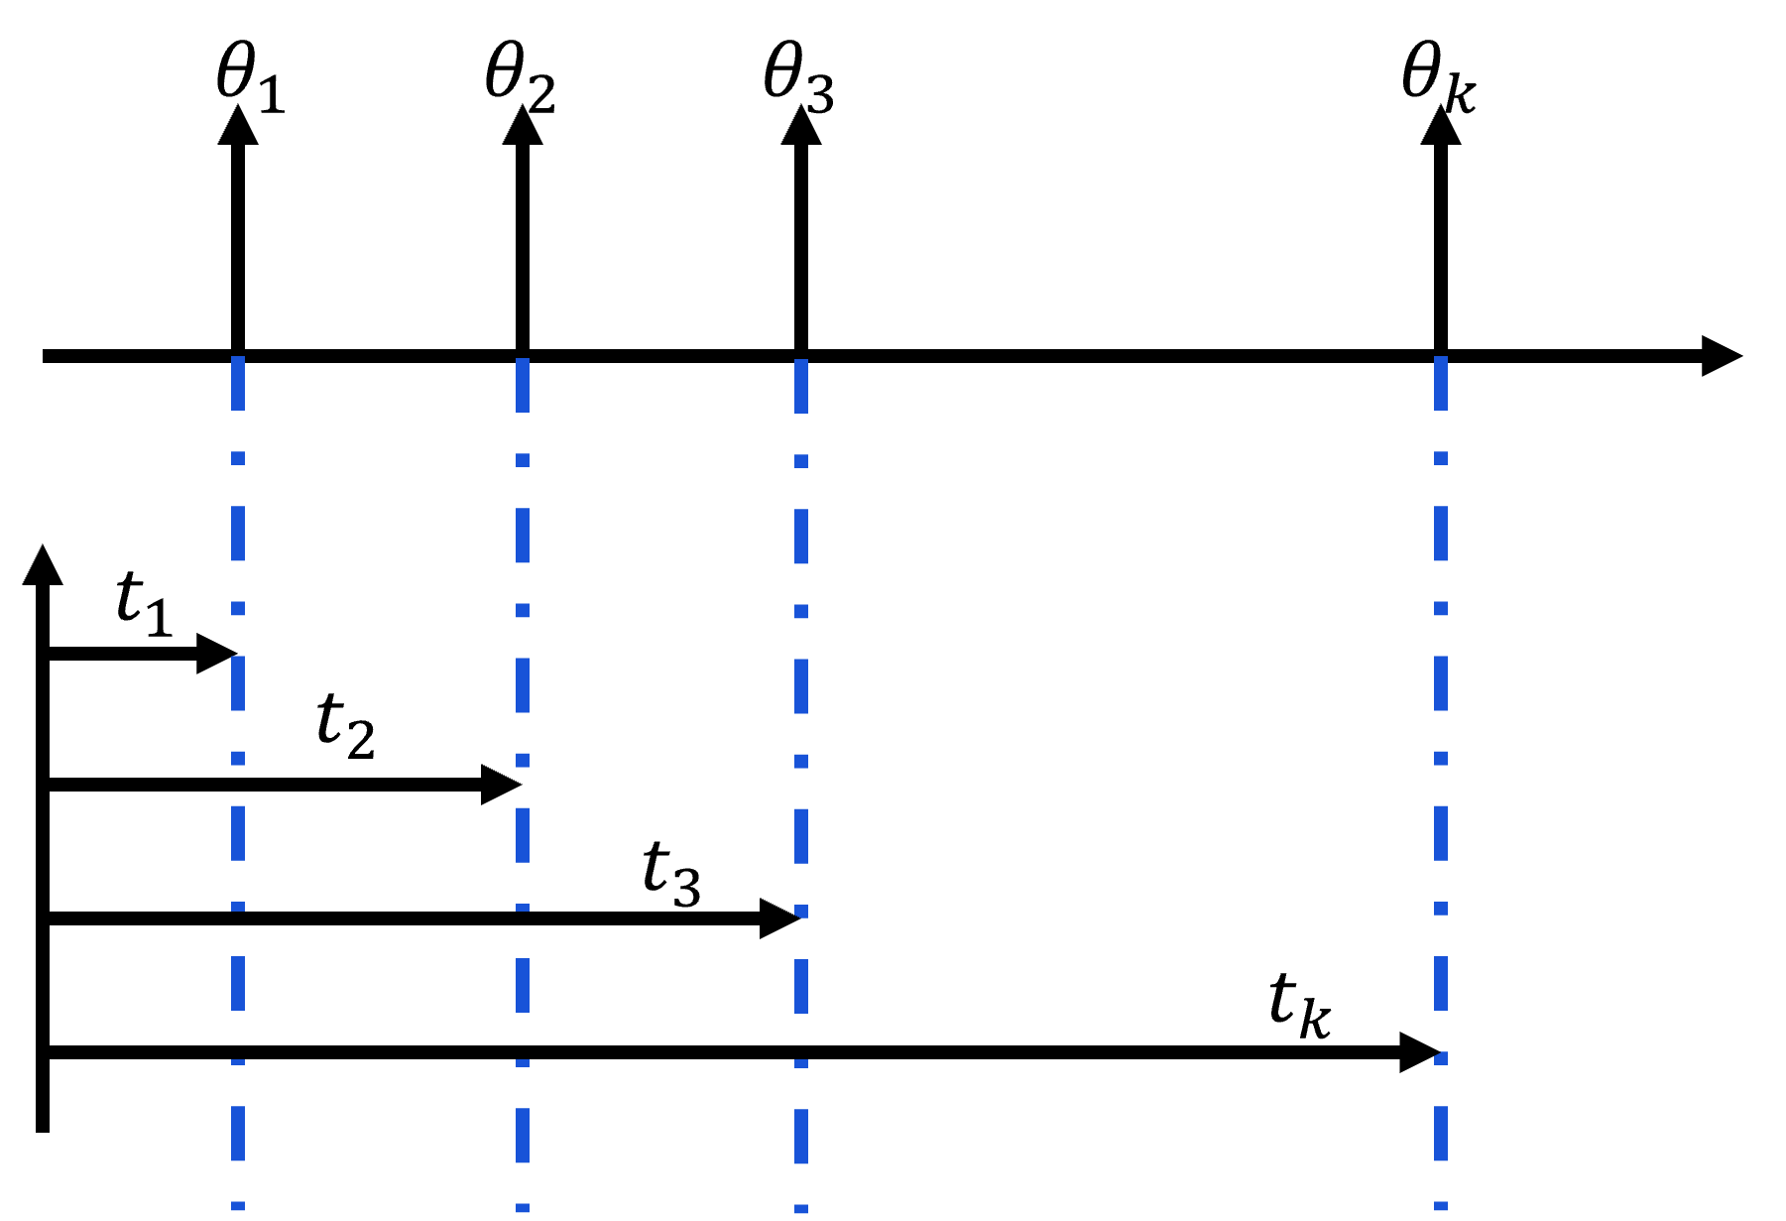
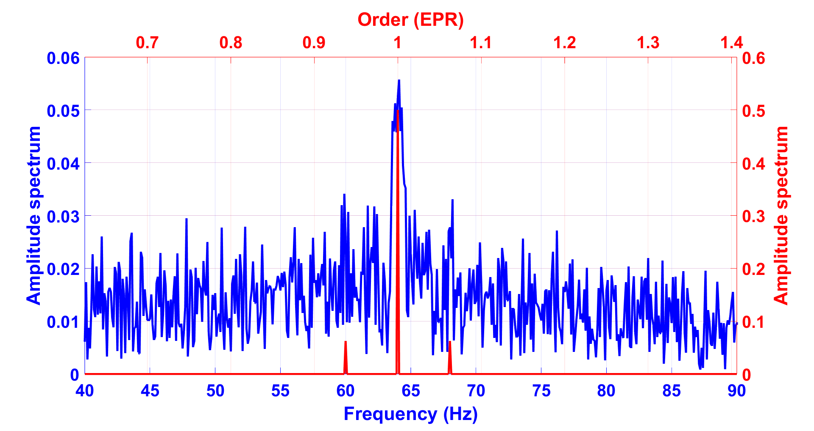
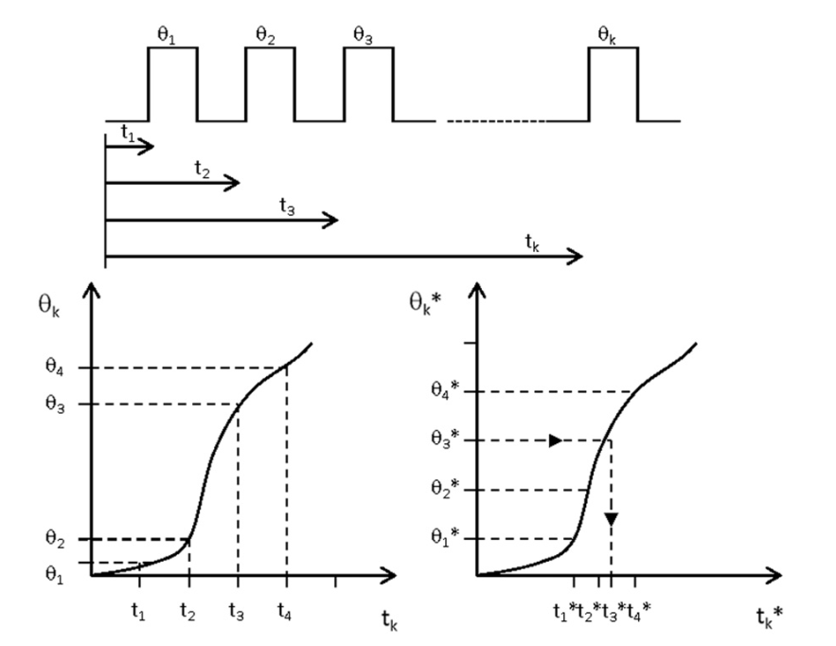
Time-frequency fault map
Vibration signal in time domain
Tachometer Signal
The angular resampling approach
1. Estimate the correspondence between the time domain and the angular domain.
2. Estimate the angular signal through interpolation.
Resampling in angular domain
Time synchronous Averaging
STFT for each carrier revolution
Compute the variance of STFT maps

Slide 8
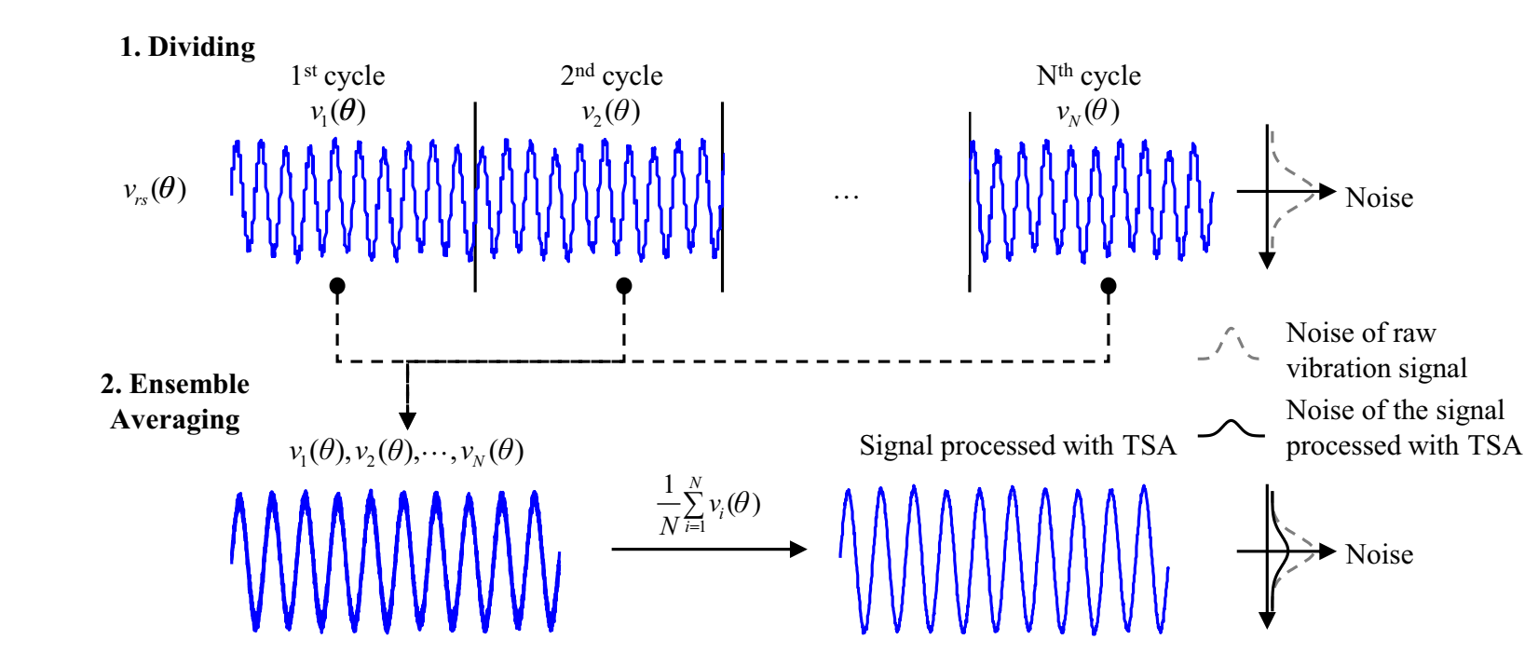
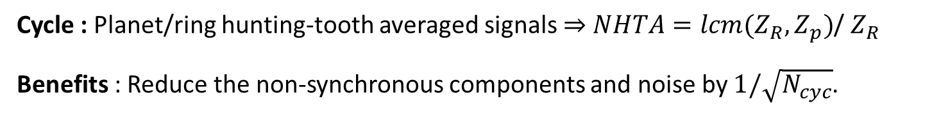
Time-frequency fault map
Vibration signal in time domain
Tachometer Signal
Time synchronous Averaging
Resampling in angular domain
Time synchronous Averaging
STFT for each carrier revolution
Compute the variance of STFT maps
Cycle : Planet/ring hunting-tooth averaged signals $⇒$ $NHTA=lcm(Z_{R},Z_{p})$/ $Z_{R}$
Benefits : Reduce the non-synchronous components and noise by $1/\sqrt{N_{cyc}}$.
Ha, J. M., Youn, B. D., Oh, H., Han, B., Jung, Y., & Park, J. (2016). Autocorrelation-based time synchronous averaging for condition monitoring of planetary gearboxes in wind turbines. Mechanical Systems and Signal Processing, 70, 161-175.

Slide 9
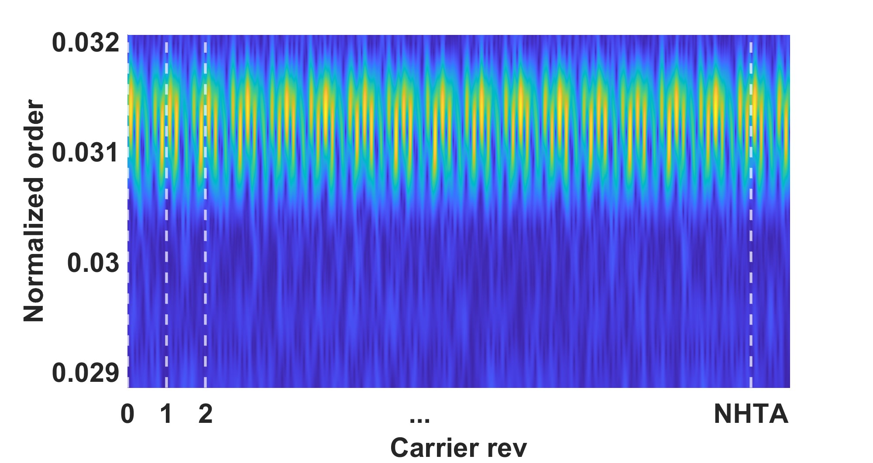
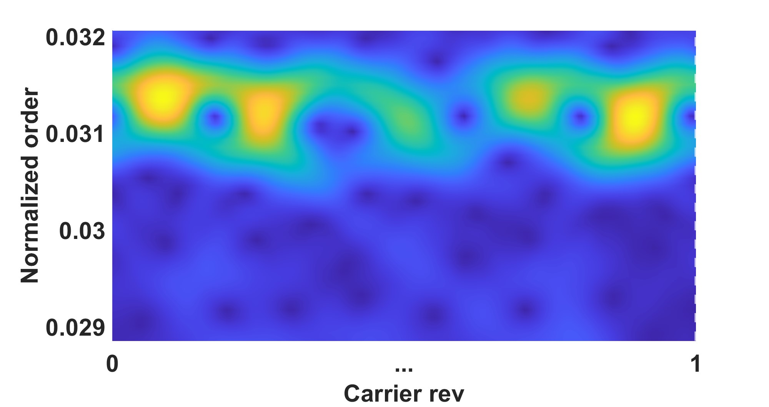
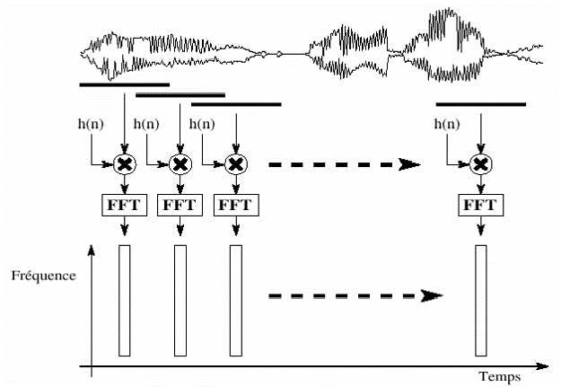
Time-frequency fault map
Vibration signal in time domain
Tachometer Signal
Short-Time Fourier Transform
Resampling in angular domain
Time synchronous Averaging
STFT for each carrier revolution
Compute the variance of STFT maps
Tradeoff : Time resolution Vs frequency resolution.

Slide 10
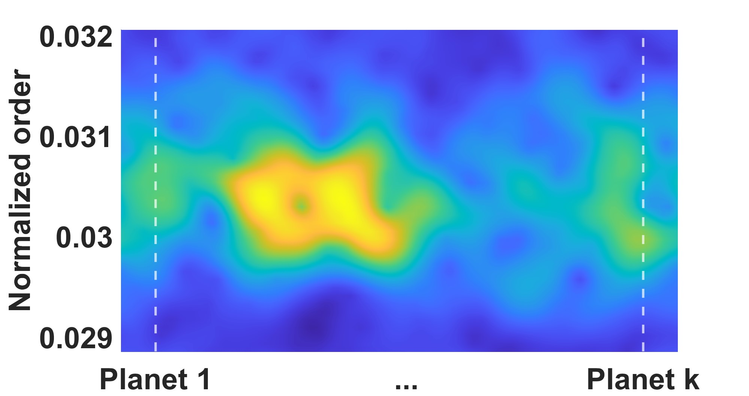
Time-frequency fault map
Vibration signal in time domain
Tachometer Signal
Short-Time Fourier Transform
Objectif : The variance of the STFT maps highlights the regions where the variability is maximum due to a different planet passing close to the sensor.
Resampling in angular domain
Time synchronous Averaging
STFT for each carrier revolution
Compute the variance of STFT maps

Slide 11

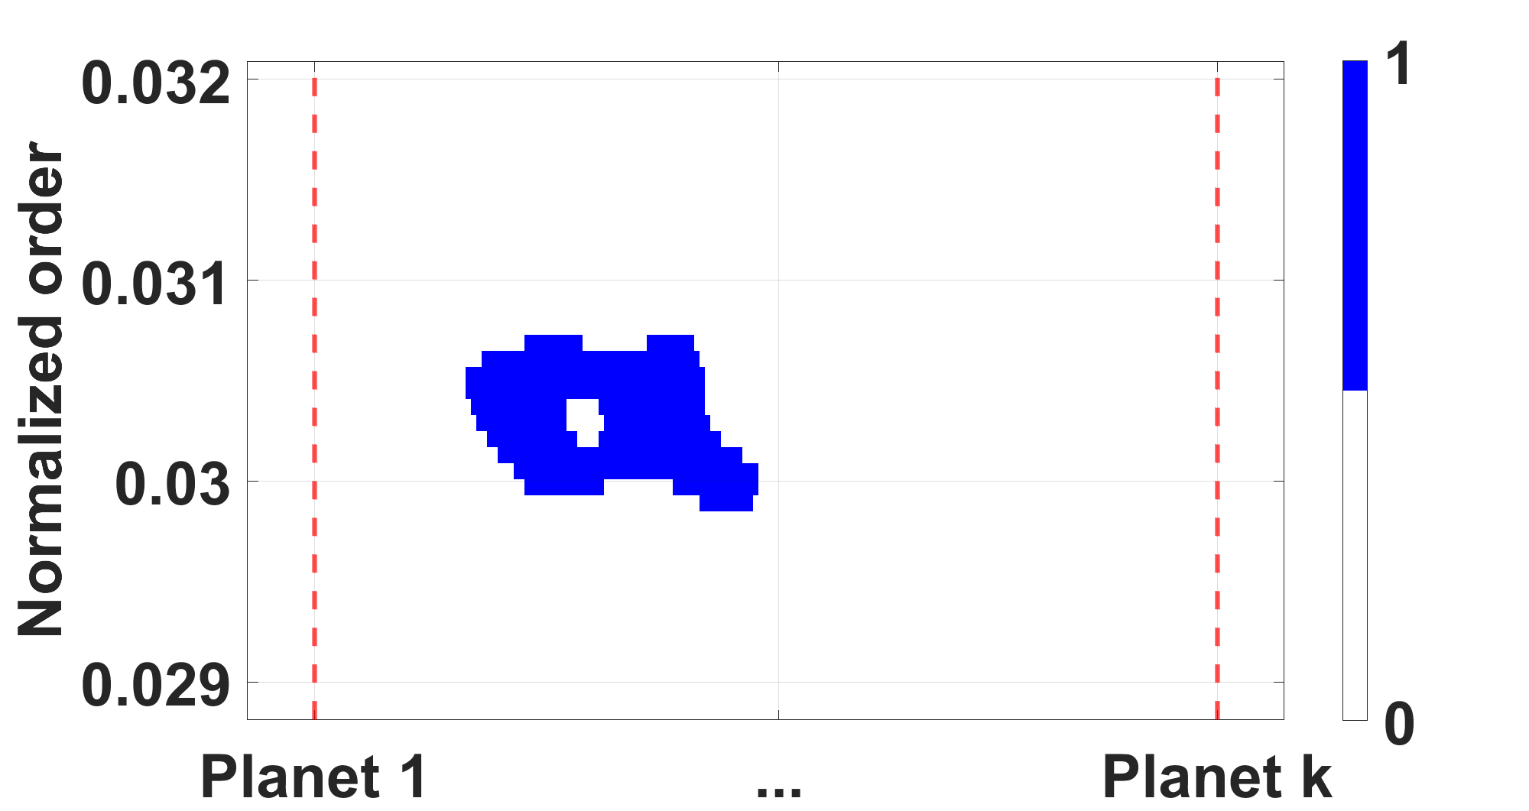

The linearization of time-frequency fault map
The linearization method
Determine the $N$ highest points in the map
Create a new class and select a reference point (max)
No
End
All the points are assigned to a class?
Define the previous points as reference points.
Yes
Assign nearby points the same class as the reference point
No
Yes
More nearby points ?

Slide 12
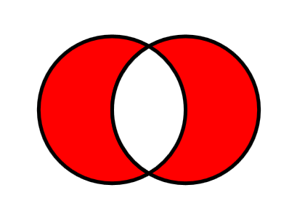

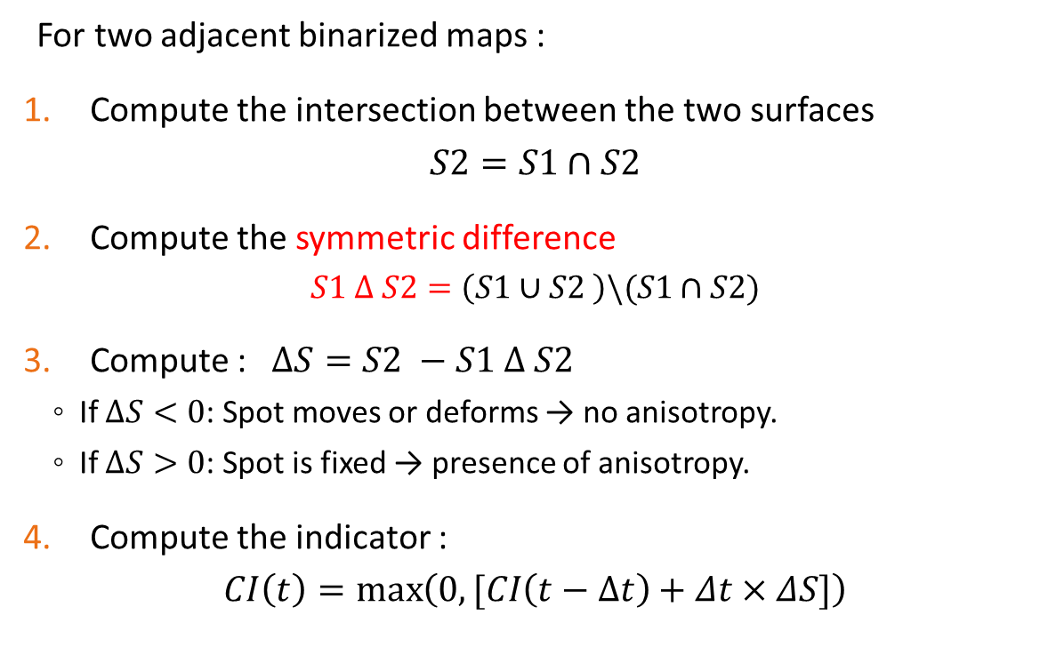

The proposed indicator
Steps
For two adjacent binarized maps :
Compute the intersection between the two surfaces
$$S2=S1∩S2$$
Compute the symmetric difference
$$S1 ∆ S2=\left(S1∪S2 \right)\backslash (S1∩S2)$$
Compute : $ΔS=S2 −S1 ∆ S2$
  If $ΔS<0$: Spot moves or deforms → no anisotropy.
  If $ΔS>0$: Spot is fixed → presence of anisotropy.
Compute the indicator :
$$CI\left(t\right)=\max\left(0,[CI\left(t−Δt\right)+Δt×ΔS]\right)$$
Spot at $t−Δt$
Spot at $t$
S1
S2
S3

Slide 13
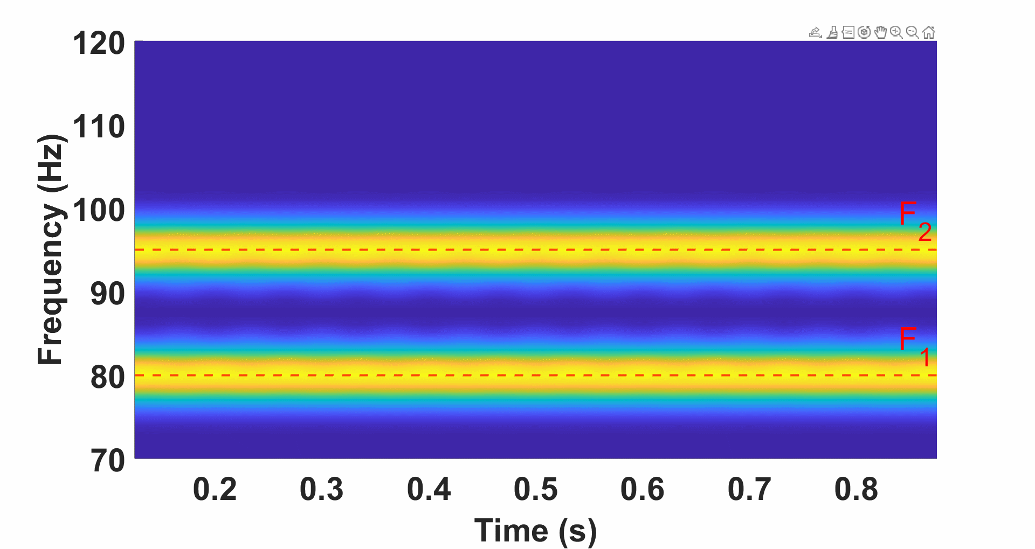
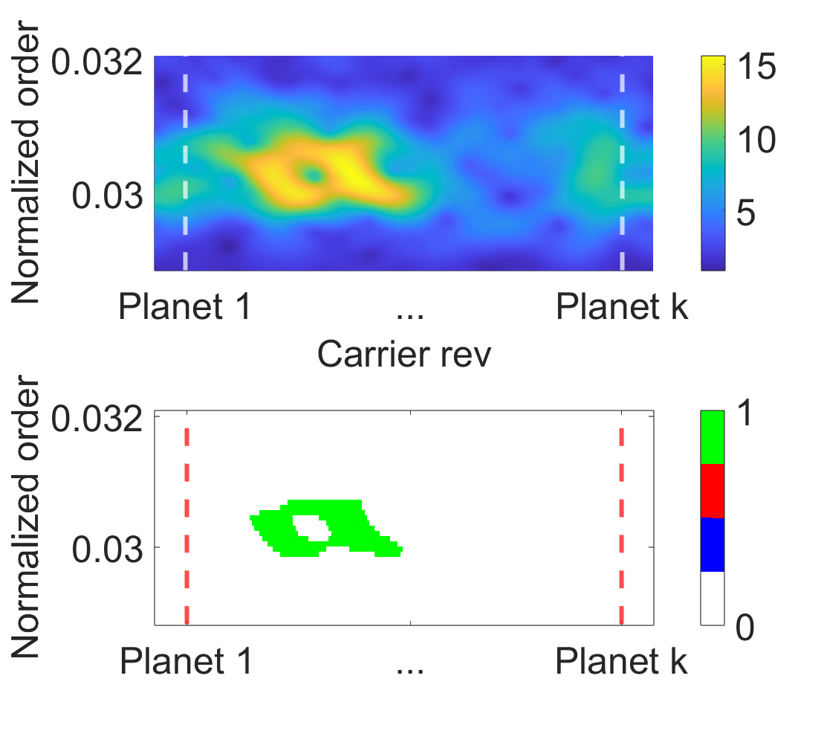
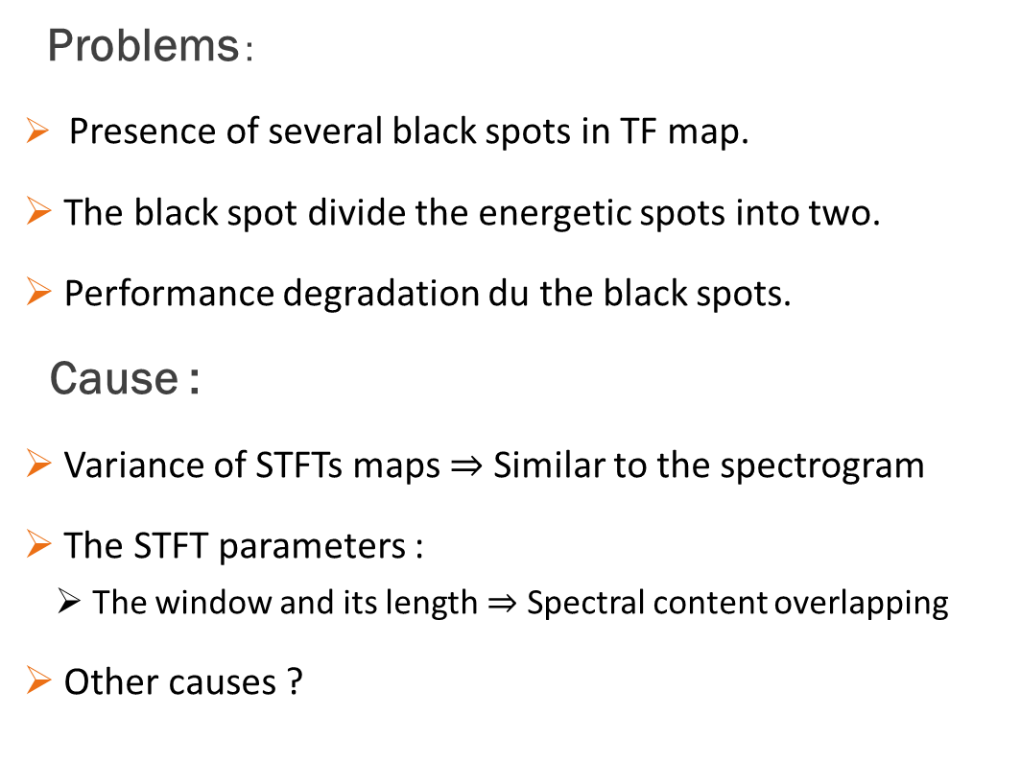
The problem with the proposed map
Black holes
Problems :
Presence of several black spots in TF map.
The black spot divide the energetic spots into two.
Performance degradation du the black spots.
Cause :
Variance of STFTs maps $⇒$ Similar to the spectrogram
The STFT parameters :
  The window and its length $⇒$ Spectral content overlapping
Other causes ?

Slide 14
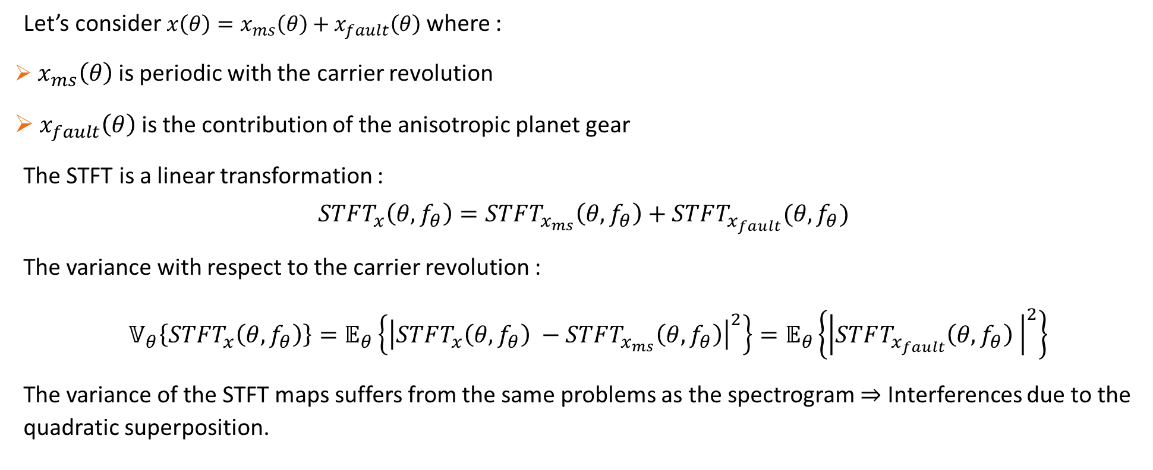
The problem with the proposed map
Variance of STFT maps
Let’s consider $x\left(θ\right)=x_{ms}\left(θ\right)+x_{fault}\left(θ\right)$ where :
$x_{ms}\left(θ\right)$ is periodic with the carrier revolution
$x_{fault}\left(θ\right)$ is the contribution of the anisotropic planet gear
The STFT is a linear transformation :
$$STFT_{x}\left(θ,f_{θ}\right)=STFT_{x_{ms}}\left(θ,f_{θ}\right)+STFT_{x_{fault}}(θ,f_{θ})$$
The variance with respect to the carrier revolution :
$𝕍_{θ}\left\{STFT_{x}\left(θ,f_{θ}\right)\right\}=𝔼_{θ}\left\{{\left|STFT_{x}\left(θ,f_{θ}\right) −STFT_{x_{ms}}\left(θ,f_{θ}\right)\right|}^{2}\right\}=𝔼_{θ}\left\{{\left|STFT_{x_{fault}}\left(θ,f_{θ}\right) \right|}^{2}\right\}$
The variance of the STFT maps suffers from the same problems as the spectrogram $⇒$ Interferences due to the quadratic superposition.

Slide 15
The problem with the proposed map
Black holes
Solutions :
Chose another Time-Frequency Representation with better TF resolution:
  Use a TFR from the Cohen class to attenuate interferences
Reduce the interference by reducing the number of components in signal:
  Filtering around the frequencies of interest
Improvement :
Reduce the resonance phenomena :
  Spectral whitening
Focus on a region of interest :
  Use the Zoom-fft technique to accelerate the TF maps computation.

Slide 16
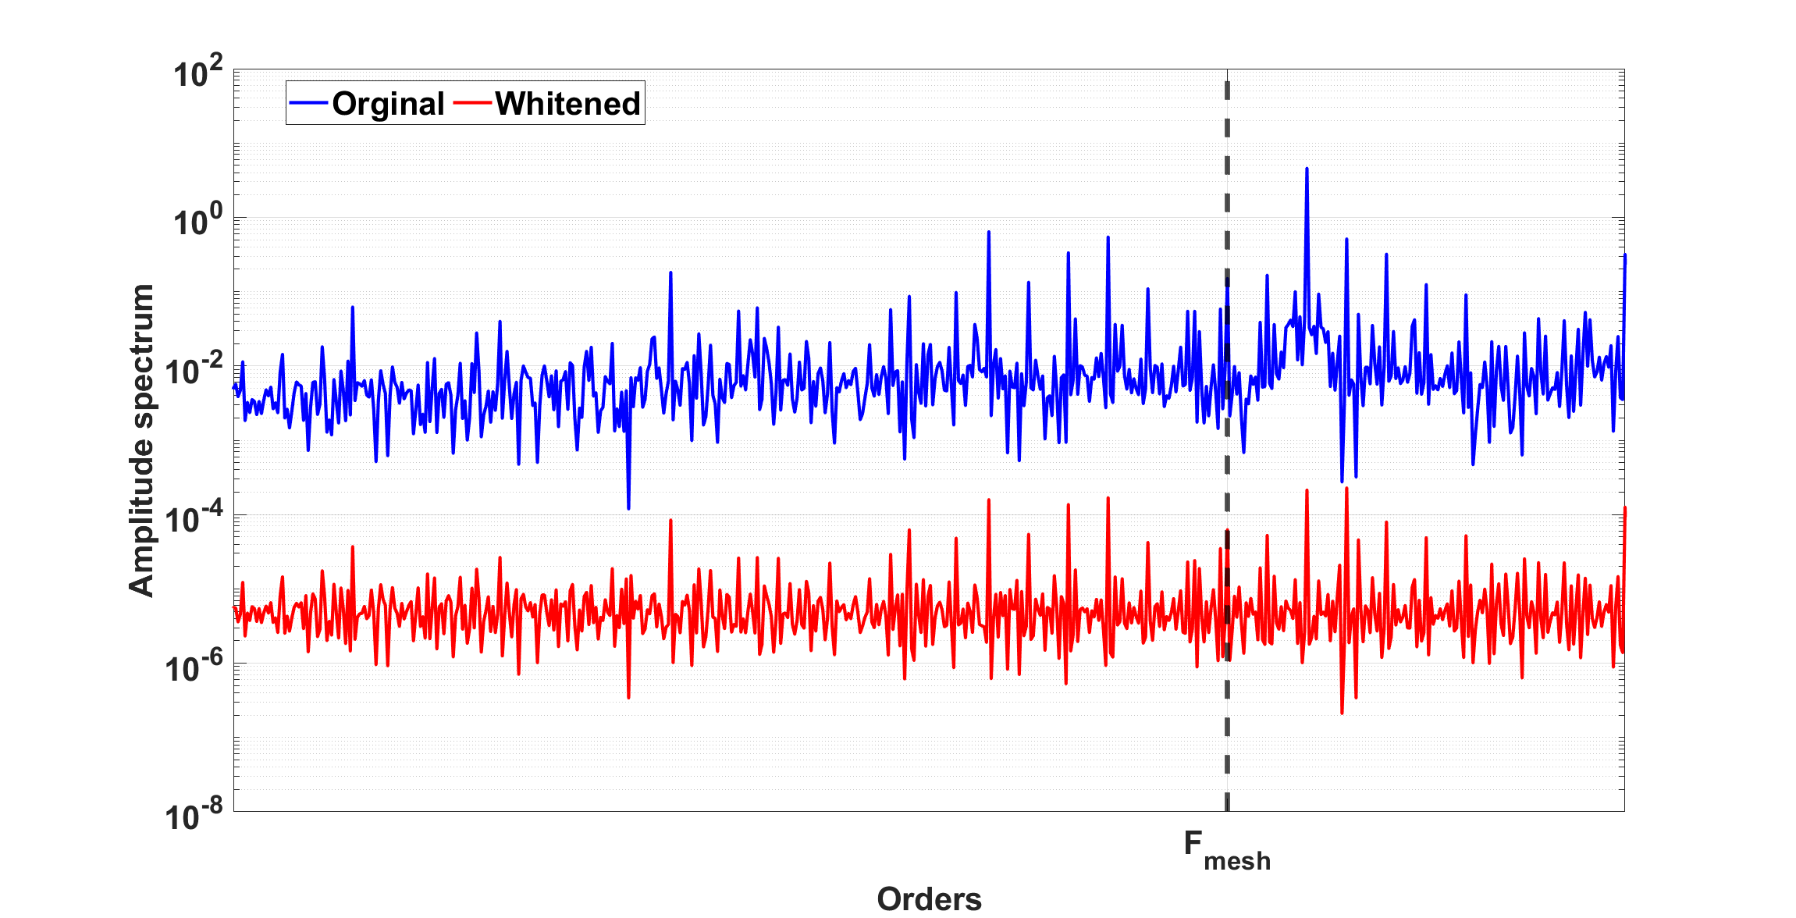
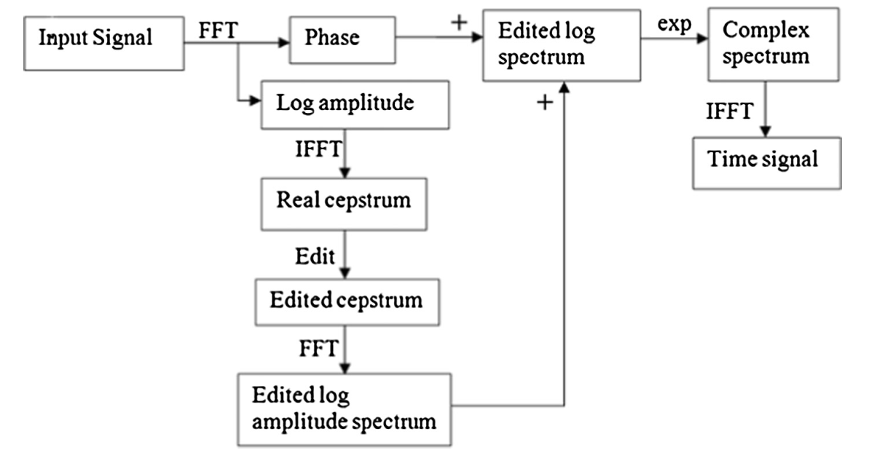
Improved time-frequency map
Vibration signal in time domain
Tachometer Signal
Spectral Whitening
Resampling in angular domain
Time synchronous Averaging
Spectral Whitening
Filtering around fault frequencies
SPWVD for each carrier revolution
Benefits : modify the spectral characteristics of a signal to make it more "white" or evenly distributed across the frequency spectrum.
Compute the mean of all the SPWVD
Randall, R. B. (2017). A history of cepstrum analysis and its application to mechanical problems. Mechanical Systems and Signal Processing, 97, 3-19.

Slide 17
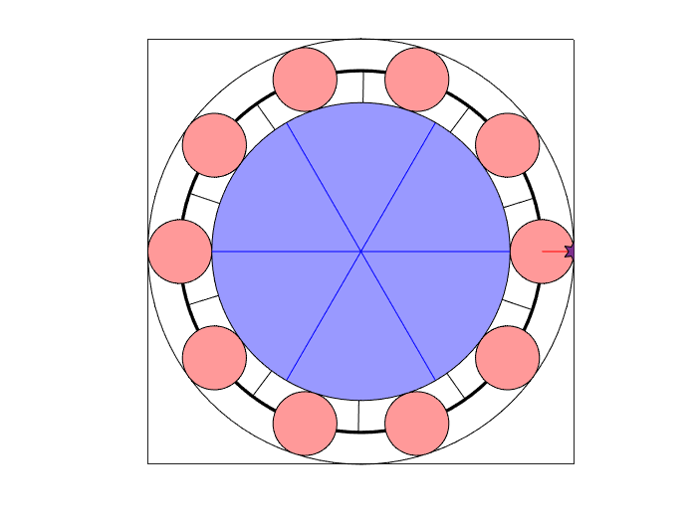
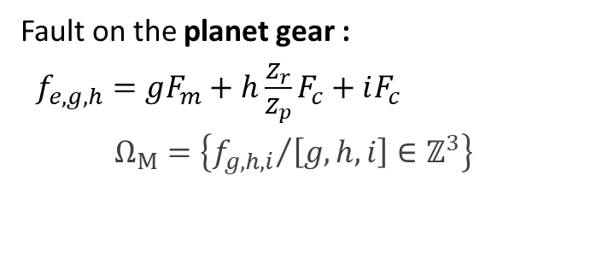
Improved time-frequency map
Vibration signal in time domain
Tachometer Signal
Filtering around fault frequencies (Model)
Fault on the planet gear :
  $f_{e,g,h}=gF_{m}+h\frac{Z_{r}}{Z_{p}}F_{c}+iF_{c}$
  $$Ω_{M}=\left\{{f_{g,h,i}}/{\left[g,h,i\right]}∈ℤ^{3}\right\}$$
Resampling in angular domain
Time synchronous Averaging
Spectral Whitening
Benefits :
- Sensitivity to only planet gears anisotropy.
- Sensitivity to incipient planet gears anisotropy.
Method :
- Set all other Fourier coefficients besides the fault frequencies to zero in the spectrum.
Filtering around fault frequencies
SPWVD for each carrier revolution
Compute the mean of all the SPWVD
Feng, Z., & Zuo, M. J. (2012). Vibration signal models for fault diagnosis of planetary gearboxes. Journal of Sound and Vibration, 331(22), 4919-4939.

Slide 18
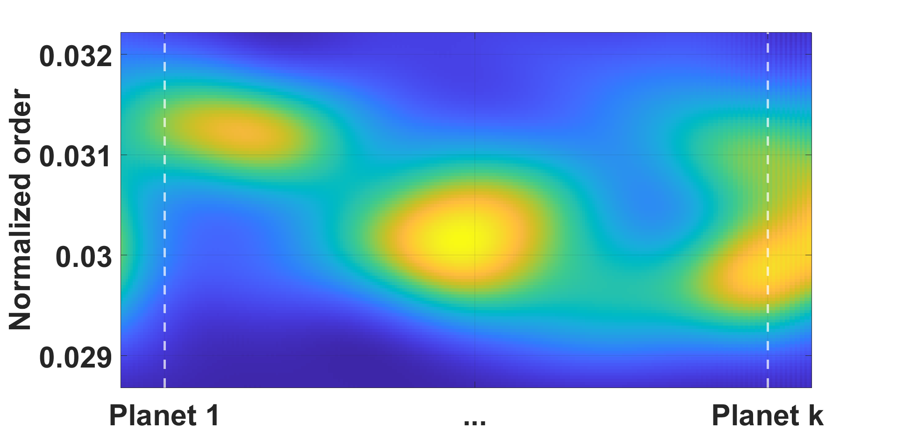
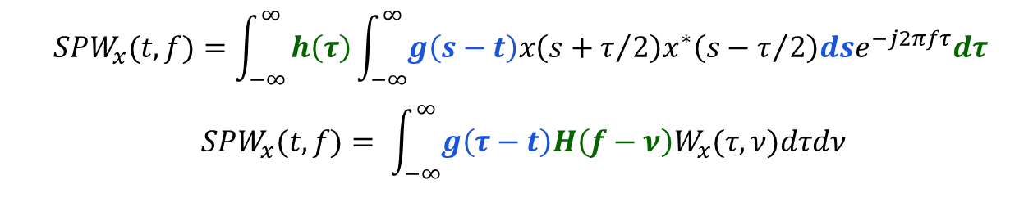
Improved time-frequency map
Vibration signal in time domain
Tachometer Signal
Smoothed Pseudo Wigner-Ville Distribution
The SPWVD is a time-frequency representation that provides a detailed analysis of a signal's energy distribution in both time and frequency domains.
SPWVD uses independent windows to smooth Wigner-Ville Distribution in time and frequency.
Resampling in angular domain
Time synchronous Averaging
Spectral Whitening
$$\begin{matrix} & SPW_{x}(t,f)=\int_{−∞}^{∞}{h\left(τ\right)\int_{−∞}^{∞}{g\left(s−t\right)x\left(s+τ/2\right)x^{∗}\left(s−τ/2\right)dse^{−j2πfτ}dτ }} \\ & \\ & SPW_{x}(t,f)= \int_{−∞}^{∞}{g\left(τ−t\right)H\left(f−ν\right)W_{x}(τ,ν)dτdν} \\ & \end{matrix}$$
Filtering around fault frequencies
SPWVD for each carrier revolution
Tradeoff : Time-frequency resolution VS Cross-terms interference.
Compute the mean of all the SPWVD
Flandrin, P. (2018). Explorations in time-frequency analysis. Cambridge University Press.

Slide 19
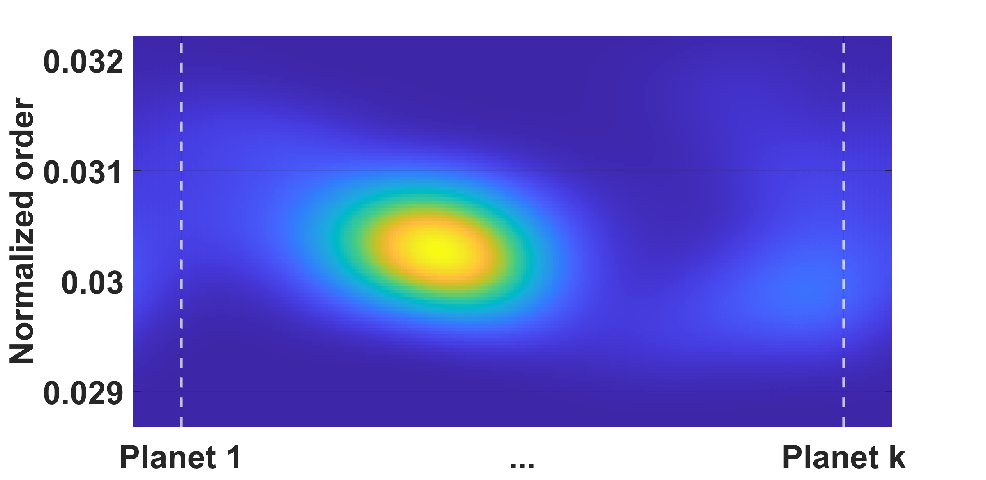
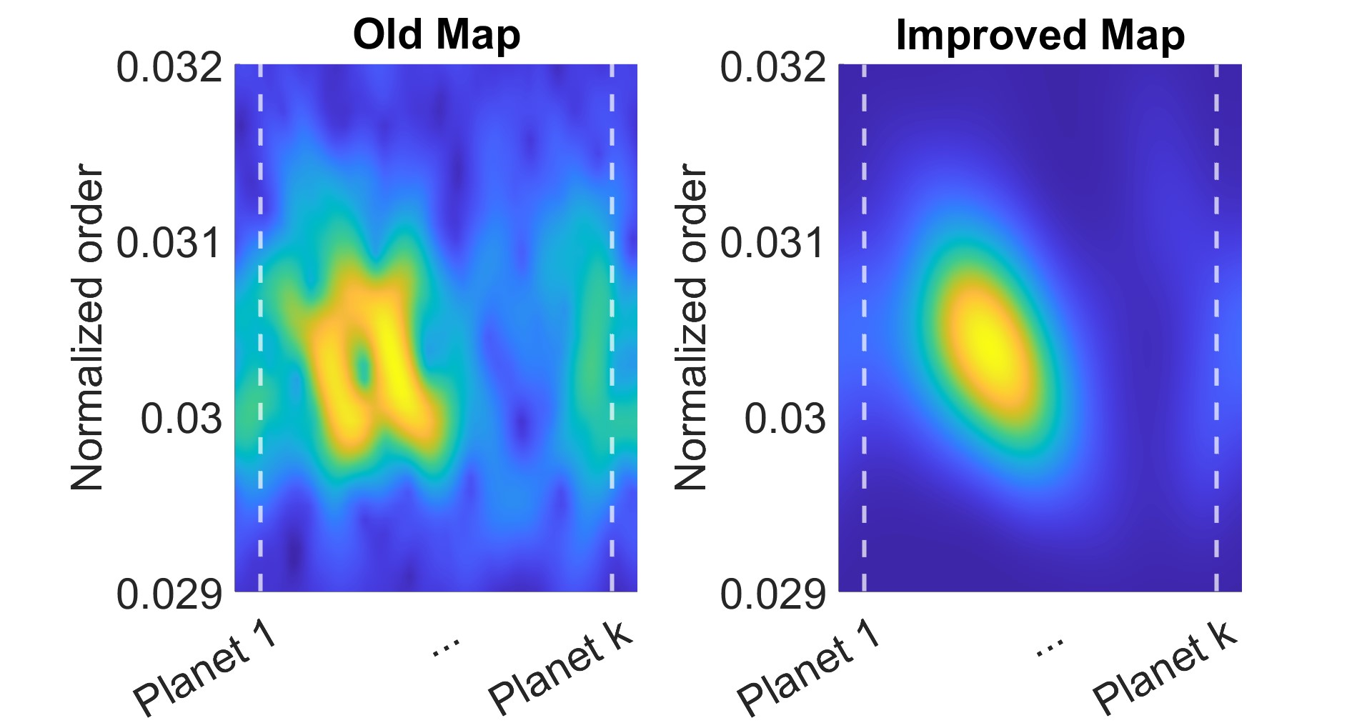
Improved time-frequency map
Vibration signal in time domain
Tachometer Signal
The final map
Resampling in angular domain
Time synchronous Averaging
Spectral Whitening
Filtering around fault frequencies
SPWVD for each carrier revolution
Benefits : Attenuate noise and non-synchronous phenomenon.
Compute the mean of all the SPWVD

Slide 20
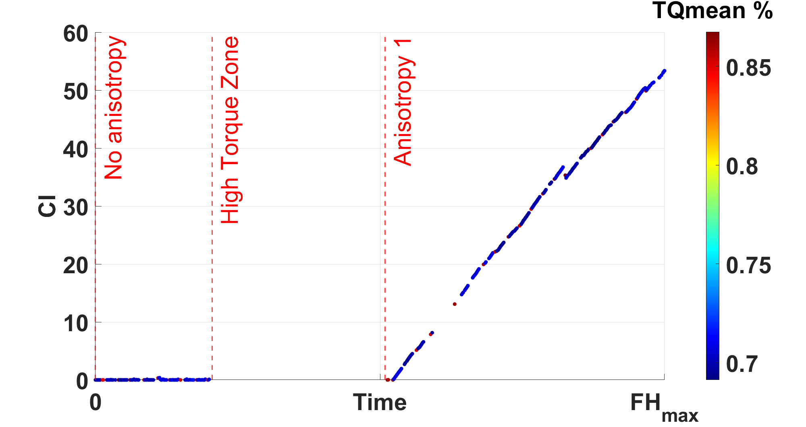
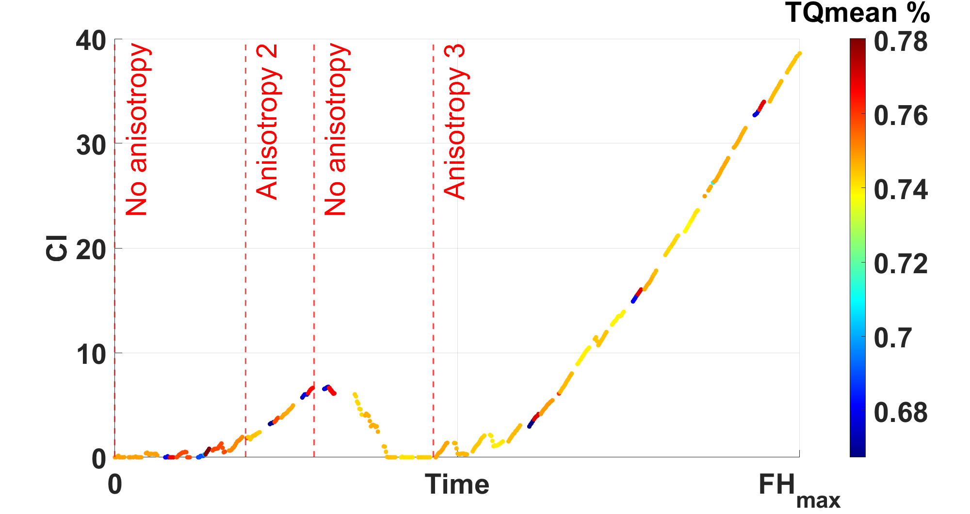
Experimental results
Simulation on Airbus Databases
Data : Vibration sensor mounted on the housing radially and one tachometer sensor on the planet carrier shaft
Algorithm configuration : Confidential !
For database N° 1:
  A planet gear fault, denoted anisotropy 1, appeared after a high torque regime.
For database N° 2:
  The indicator increases as soon as a healthy planet gear was replaced by a faulty one.
  The indicator decreases when we switch the planet gears again.
  The indicator increases again after initiating a planet gear fault through high load

Slide 21
Conclusion
The Time Frequency Representation are
  Adapted to analyze non-stationary signals from real world complex application.
  Useful for developing health indicators for machine monitoring systems.
To overcome some time frequency representation problems :
  Choose the optimal TFR methods by taking into consideration the time frequency resolution, the interference / cross terms, and the computation cost.
  Use preprocessing techniques to optimize and enhance the time frequency maps.
Next steps :
  Use and Enhance the spectrogram maps (low computation time and complexity).
  Find new ways to compute robust indicators from TFRs.

Slide 22
Thank you for your attention
LASPI
UJM - Saint Etienne

